Slide 1

Agile Software Development
Measurements, Reporting and Tools
SoftUni Team
Technical Trainers
Software University
http://softuni.bg

Slide 2
Table of Contents
Team Velocity – recapture.
Other measurements for productivity in Agile.
Team Moral in Agile.
Priorities based on Client’s needs.
Defining the right size.
Measurements in Agile.
Velocity.
Team Morale.
Quality.
Customer Satisfaction.
Tools to use at Agile.

Slide 3
Have a Question?
sli.do #Agile-2021

Slide 4

Team Velocity – recapture

Slide 5
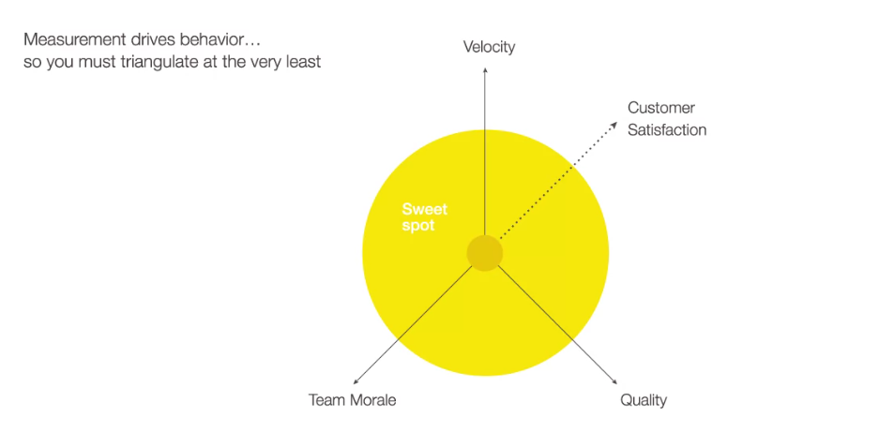
Measuring, Reporting and Tools

Slide 6
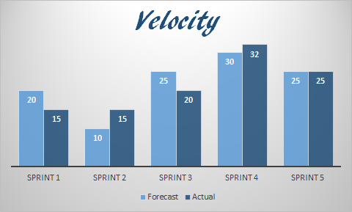
Team Velocity
Measures the speed of the Agile team.
Completed after each iteration.
Based on the number of User Stories completed, but most important, on the total number of points completed in an iteration.

Slide 7
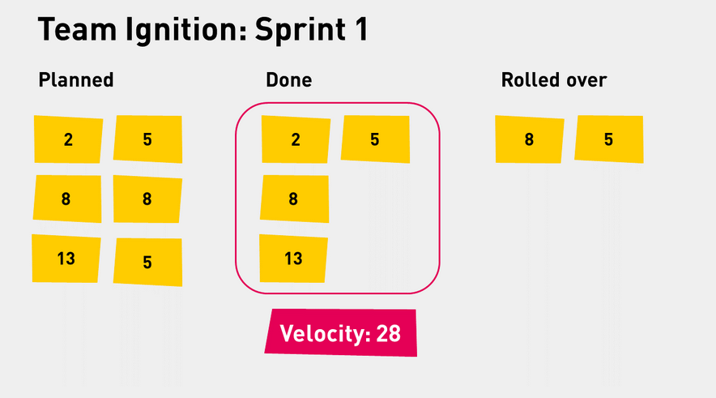
Team Velocity – how does it work?
After Sprint /iteration/ 1

Slide 8
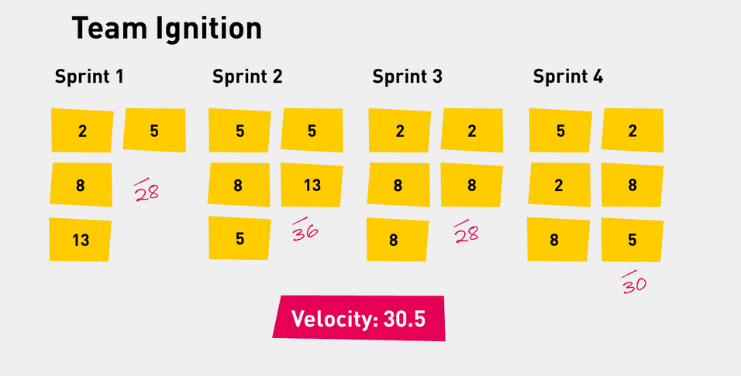
Team Velocity
After Project completion

Slide 9

Other measurements for productivity in Agile

Slide 10
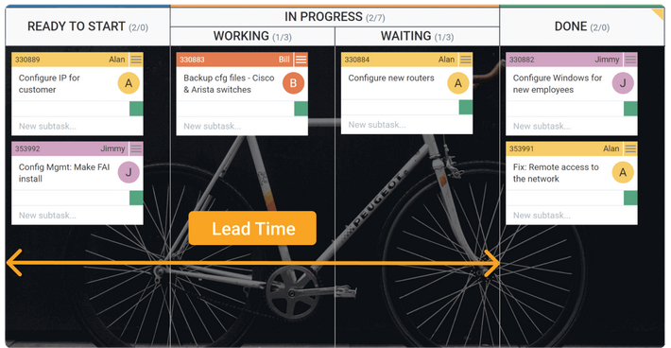
Other Measurements defining the speed and productivity of the Agile Team
Lead Time
Allows for monitoring a story from the point when it enters a backlog to a sprint’s end.
The lower it is, the more effective your development process is.
Lead Time is one of those agile metrics that allows for gaining an overarching perspective on the productivity of your team’s efforts.
It could be measured in minutes, hours, or days.

Slide 11
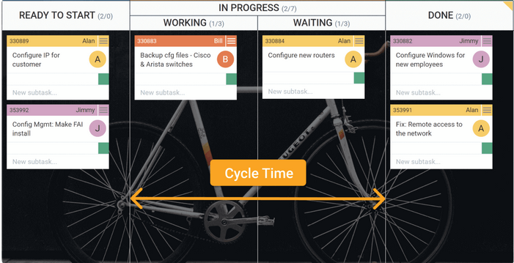
Other Measurements defining the speed and productivity of the Agile Team
Cycle Time:
When a new assignment is “pulled” by the Agile Team and someone is working on it.
It shows how fast the team process work.

Slide 12

Team Moral in Agile

Slide 13
Team Morale

Slide 14
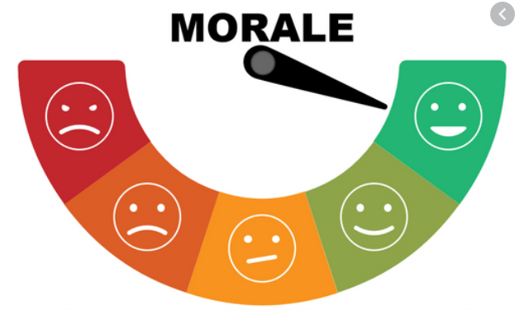
Team Morale
People are the most important aspect in a project/organization.
Think of the Agile Manifesto/Principles.
So what practices are out there to help us define the morale?

Slide 15
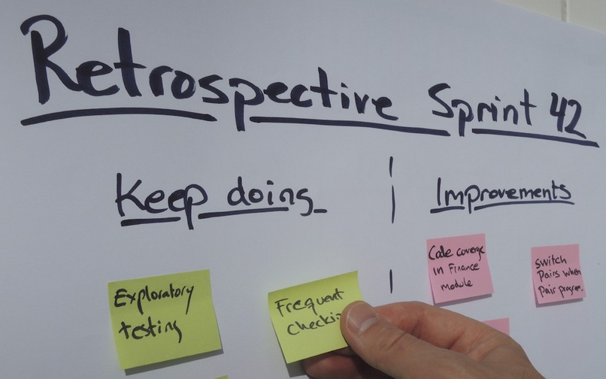
Team Morale

Slide 16

Pulse survey
Used by most companies.
Short questions.
I feel fit and strong in my team
I am proud of the work that I do for my team
I am enthusiastic about the work that I do for my team
I find the work that I do for my team of meaning and purpose
It gives an overview for the higher management if all team members are engaged.
Centrally executed, usually once a year.

Slide 17
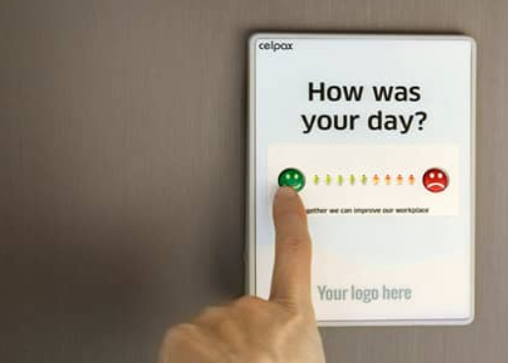
Team Morale
Measure effective.
Good to have an overall chart which shows development (or devolving) of the team moral.
Don’t overdo it!
There are many other creative ways, games, or technologies to help us.

Slide 18
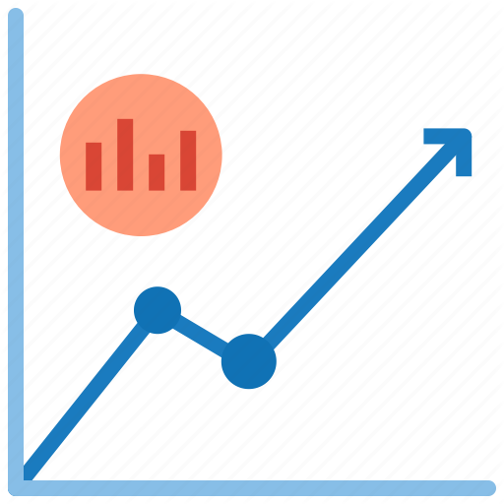
Measurements in Agile

Slide 19
Measuring Quality in Agile

Slide 20
Measuring Quality in Agile
There are three main types of agile metrics:
Scrum metrics. The most commonly used metrics in software development.
Kanban metrics. An agile software / none software development framework similar to the scrum methodology.
Lean metrics. Metrics used to streamline the manufacturing of physical products, from which both Kanban and scrum originate.

Slide 21

Measuring Quality in Agile
Escaped Defects
Help’s identify the number of bugs in a build or release after it enters production.
In manufacturing, the measurement might focus on number of defects (Lean methodology).
It helps drive down the waste and focus on a better product.

Slide 22
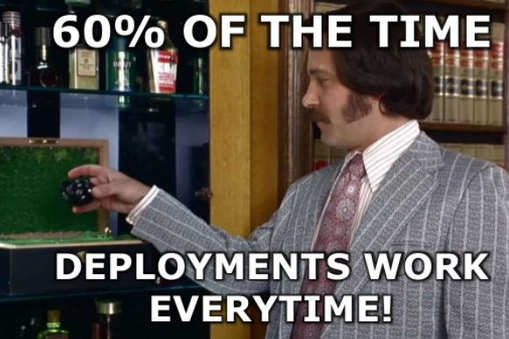
Measuring Quality in Agile
Failed Deployments
Failed deployments can shed light on how reliable and stable are the new deployments.
If the team is building working software at all.
Can use the failed deployments metrics to understand whether a given sprint or release is ready to go to production.
The number should be as close to “0” as possible.
It helps prevent major issues.

Slide 23
Other methods to measure quality
Code Coverage:
will help calculate how much of your product’s code is covered by unit tests, presenting it in a raw visualization.
It is applicable if testing is not implemented automatically.
It is not recommend to use a sole measurement technique.

Slide 24
Other methods to measure quality
Cumulative Flow
a powerful method to provide metrics in Kanban.
It gives you a bird’s-eye view on the statuses of your tasks in a sprint, release, and across software teams.
With this metric, you will be able to view all statuses for all workflow stages and immediately identify bottlenecks — all in a single diagram.
Probably there are many more to be explored.

Slide 25
Agile Measurements – CS + Quality

Slide 26
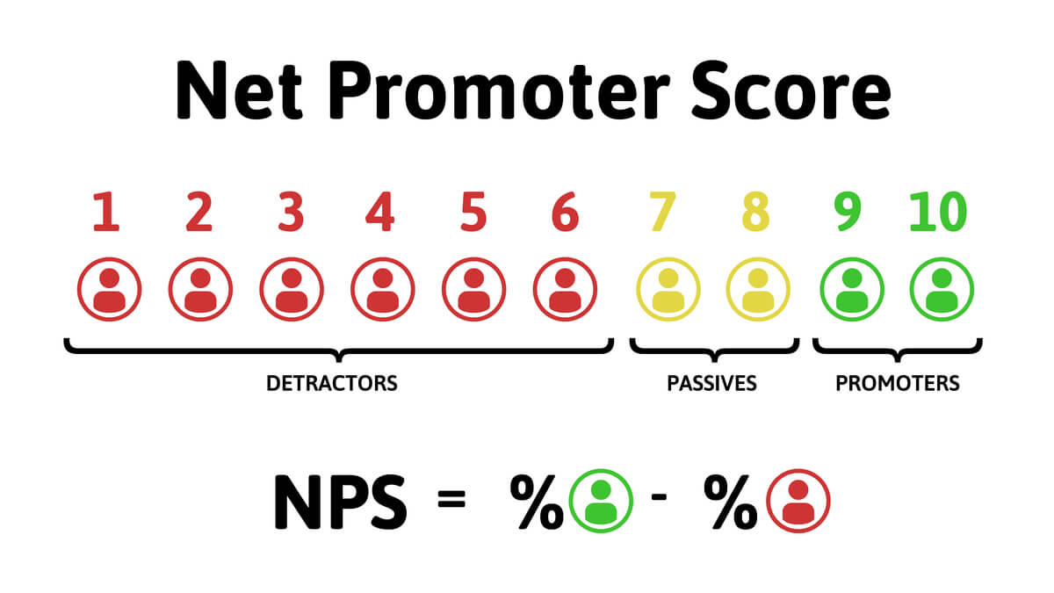
Agile Measurements – CS + Quality

Slide 27
Agile Measurements – CS + Quality
Net Promoter Score (NPS).
It is often executed in the form of a survey.
Keep the number of questions to its minimum.
Use short, but well targeting questions.
Timing in essential.

Slide 28

Agile Measurements – CS + Quality
Structured, or semi structured Interview.
Larger intervals – once in a year.
Target your audience.
Be aware that the technique takes time and effort on both sides.
Respect time.

Slide 29
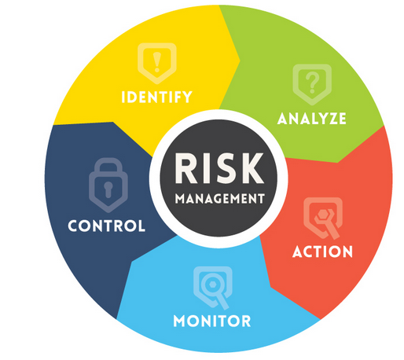
Measuring risk in Agile
Understanding Risk is an important part of any project – Agile, or not.
Risks in Agile are no different from other type of projects.
So where is the difference?

Slide 30
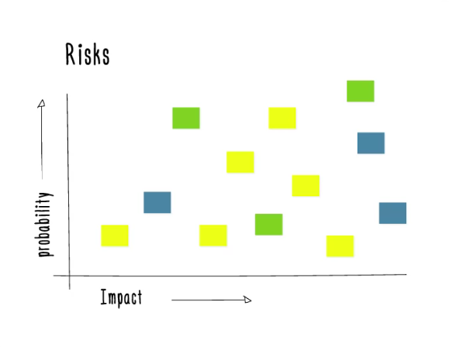
Measuring risk in Agile
In nature, Agile tends to run projects more light-weight.
Agile derives from self-sufficient teams, so each team can com with its own structure of how to measure risk.
Agile tries to visualize.
Everyone is involved.
Risk Vs Impact is still the main focus.
…but there are other ways to visualize risk.

Slide 31

Measuring the risk in Agile - practices
Place Major Risks in the center. The lesser the risk, the more you would go to the periphery.
Place the risk depending on its area. Typically, there are three types of risks: People, Process, Technological. Financial risk is not for the team.
Do not wait Retrospectives to place the risk. You can do it during, or after a Stand up.

Slide 32
Do you remember previous exercise?
Case 2
You work in a restaurant where you need to organize a birthday party. It is the 50th year anniversary of the guest of honor, hence the day is important. The expectation is to organize the entire event – „end to end“. To be more specific, the task to be completed are:
Creating and distributing the invitations.
Greeting and sitting each guest.
Organizing the dinner which would be a mix between cold plates and hot dishes.
Birthday cake.
Entertaining.
The restaurant you work at, is well known place for organizing such events so the expectations are high. Every item should be precisely delivered and each guest (especially the guest of honor) should feel special.
The responsibility is even greater as the estimated budget is only 5000 BGN.

Slide 33
Do you remember previous exercise?
Tasks:
Identify the risks.
Try use one of the Agile practices just presented.
Actually, any method would be ok.
You have about 15 min.

Slide 34
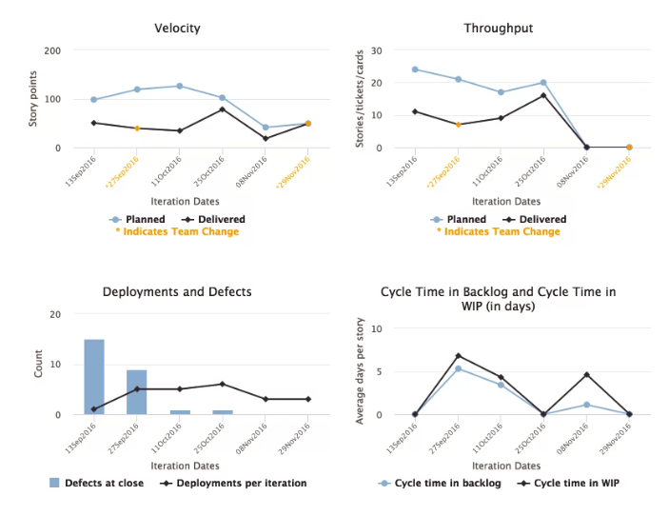
Visualizing in Agile
Visual in Agile:
Visual is important.
Make sure everyone knows where the team is currently.
It gives an overview of where the team is heading to.
Thing of this as a map.

Slide 35

Reporting in Agile

Slide 36
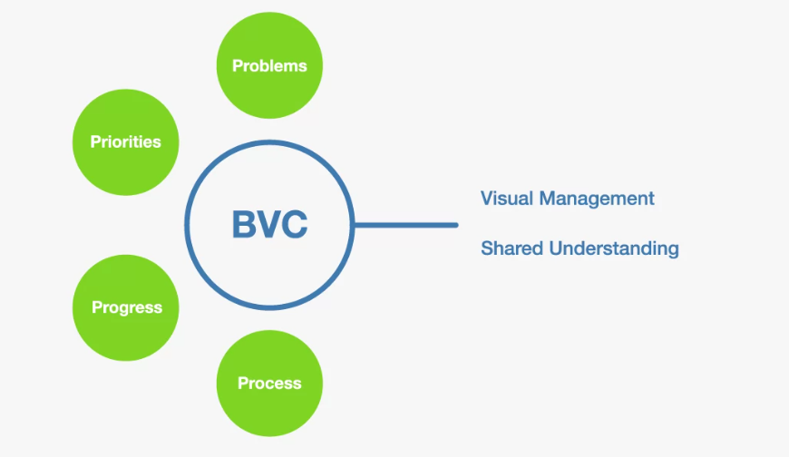
BVC – Big Visual Charts
Think of the 4 dimensions here.
Agile is driven by self-directed teams.
Do not try to hide.
Keep it current.
Simple, no need to polish.
Influential – need to send a message.
Minimal in numbers.
Do not forget to visualize the risk.
Use burn up / burn down charts.

Slide 37
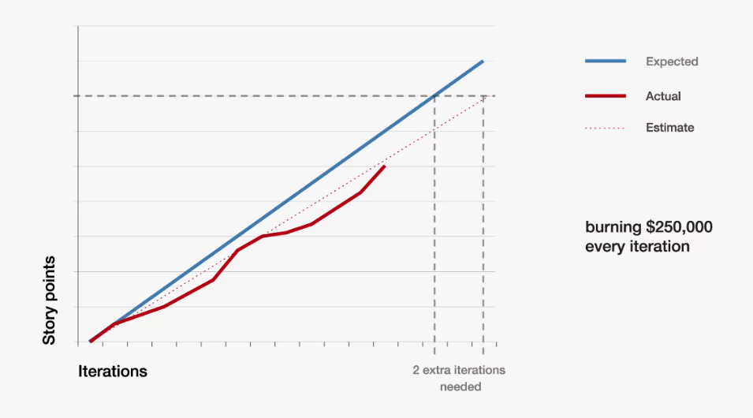
BVC – Big Visual Charts

Slide 38
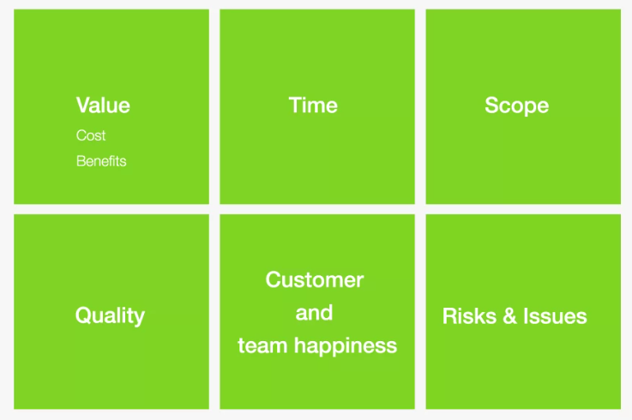
BVC – Big Visual Charts
Another way to consider what should be on the chart.
…or you can simply think what is important for the team and stakeholders.

Slide 39
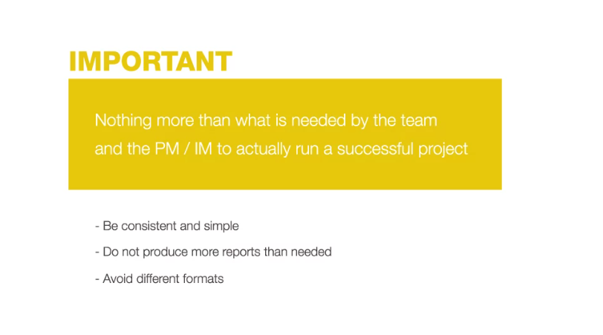
BVC – Big Visual Charts

Slide 40
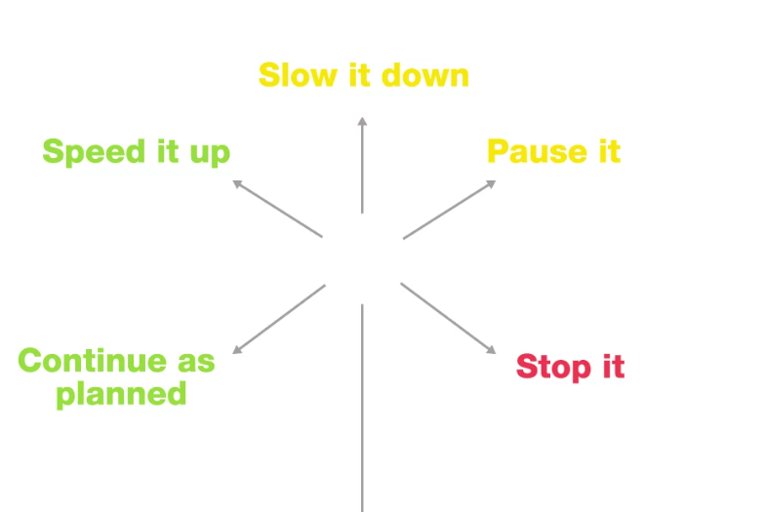
Why do we need charts?
The chart should not be an end to itself, but be able to bring conversation.
The charts should be updated after each iteration.
Every two weeks (or so) the following discussion could be triggered.
If needed, then change and iterate.
If barrier is needed, then overcome.

Slide 41
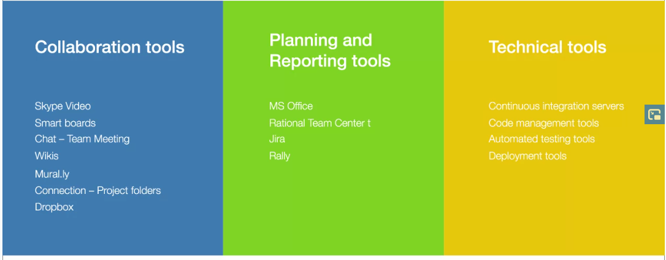
Tools to use in agile.

Slide 42
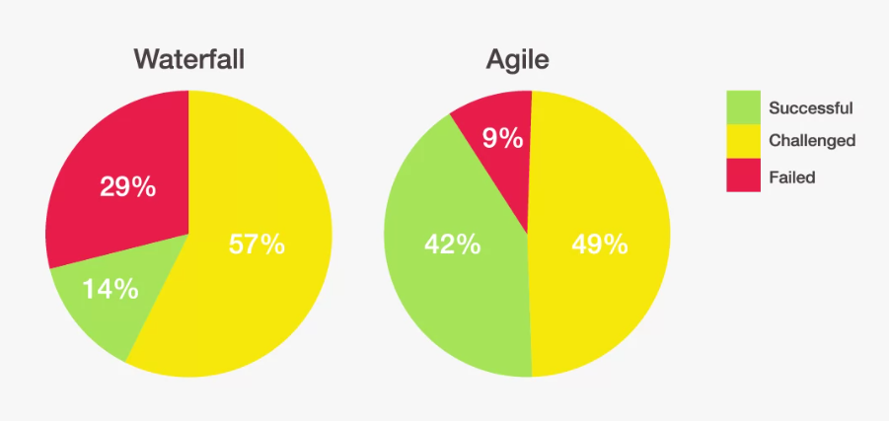
Agile – success rate
Agile could be fragile.
Do not think Agile simply because its trendy.
If something does not work – change it.

Slide 43

Summary
Measuring is key for improvement
Do not measure only one criteria
Do not measure in vacuum
Add only the information that is required
…
…
…

Slide 45













SoftUni Diamond Partners

Slide 46




SoftUni Organizational Partners

Slide 47





Trainings @ Software University (SoftUni)
Software University – High-Quality Education, Profession and Job for Software Developers
softuni.bg
Software University Foundation
http://softuni.foundation/
Software University @ Facebook
facebook.com/SoftwareUniversity
Software University Forums
forum.softuni.bg

